Slide 1
Introduction to ArcPython
Dan Mahr ‘11
10/28/2014
GEOL1320
Notes:
Thanks Lynn. Good afternoon all. I’m very excited to be here today to tell you about a tool that I use in my job everyday, and that’s ArcPython.

Slide 2
About me
GEOL1320 fall 2009
GEOL1330 (remote sensing) spring 2010
Senior thesis with MODIS data, used GIS heavily
Graduated 2011
Environmental consulting at The Cadmus Group (Waltham, MA)
Notes:
I’m especially excited to be here because this GIS class had a major impact on my academics at Brown, and on the start of my professional career. I took GEO132 five years ago in the fall of 2009. I really enjoyed it, and followed it up with GEOL133 (remote sensing) with Jack Mustard. I also integrated GIS with a lot of class and group projects throughout my junior and senior year, which always impressed professors and classmates. I ended up working with Jack on my senior thesis which used a lot of remote sensing data and GIS concepts. After graduating in 2011, I was lucky enough to start off with a job at an environmental consulting firm, doing GIS-related work during most of my time.

Slide 3
About you
How would you describe your knowledge of computer programming?
None
Basic
Intermediate
Expert
Target audience
Notes:
That’s enough about me. I also want to learn a bit about you. Who are the seniors in this class? Juniors? Sophomores and freshman?
Also, how would you describe your knowledge of computer programming? None, basic, intermediate, or expert? I’ve targeted this lecture towards those with no or only basic experience. But even if you are an expert, we’ll quickly be moving into GIS-specific territory.

Slide 4
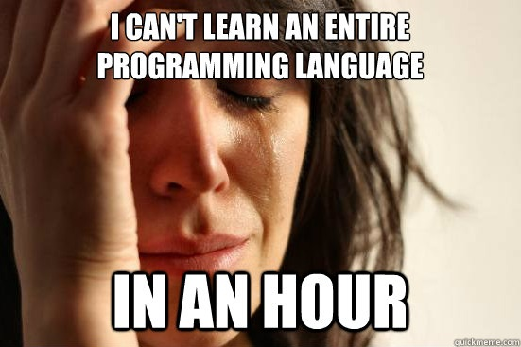
A confession: I can’t teach you Python in 60 minutes
Notes:
Now I have to confess: I can’t teach you Python, let alone ArcPython in 60 minutes. So I’m going to try to accomplish the next best thing.

Slide 5
Agenda
What is ArcPython?
Why learn arcpy?
arcpy demo: Adding fields
Showcase 1: Hydrologic analysis
Showcase 2: Batch map creation
Showcase 3: Service area model
Notes:
I’m going to break the ice with arcpy, and make it less intimidating. I’m going to explain what ArcPython is, why it’s worthwhile learning, and then I’ll shut up and we’ll do a live demo of how to make and run a basic script. Those of you who are true computer programming novices might not understand every detail of the Python syntax, but at least you will know how easy it is to get started, and that you’re only a couple minutes away from creating your own geoprocessing tool.
After that, I’m going to showcase three examples of how I’ve used arcpy to do real-world analyses for clients.

Slide 6
What is ArcPython?
Python is a programming language
Named after Monty Python
Focus on readability
Popular as scripting language
ArcPython (arcpy) is the scripting package for ArcGIS
Functions and classes for performing ArcGIS tasks from the Python
Notes:
First off, what is arcpy?
Python is a programming language that instructs computer software. It’s named after Monty Python (fun fact for the day!). For those of you who have never done any computer programming, it’s worthwhile to know that most so-called high-level languages (e.g. Python, Java, VBA) are all based on very similar concepts. So once you learn one programming language, it’s not too hard to understand other languages—this contrasts will human languages, where learning German won’t help you learning Swahili. Python’s syntax is designed around maximizing the readability of code, which makes it a good language to start with, and popular as a scripting language.
ArcPython, which is known more commonly as arcpy, is the scripting package for ArcGIS. It has functions and classes for performing ArcGIS tasks in the Python programming language.

Slide 7
Why bother learning ArcPy?
Reason #1: Scale and speed
Same reasons we learned ModelBuilder!
ArcMap interface can be cumbersome and slow
Python allows for even larger-scale processing
Notes:
Now, why should you bother learning arcpy?
The first reason is the same reason it was important to learn about ModelBuilder last week: scale and speed. We all know that the ArcMap GUI can be cumbersome and slow. ModelBuilder can automate lots of these repetitive tasks. But ModelBuilder has its limits before it gets too confusing, like in this example.

Slide 8
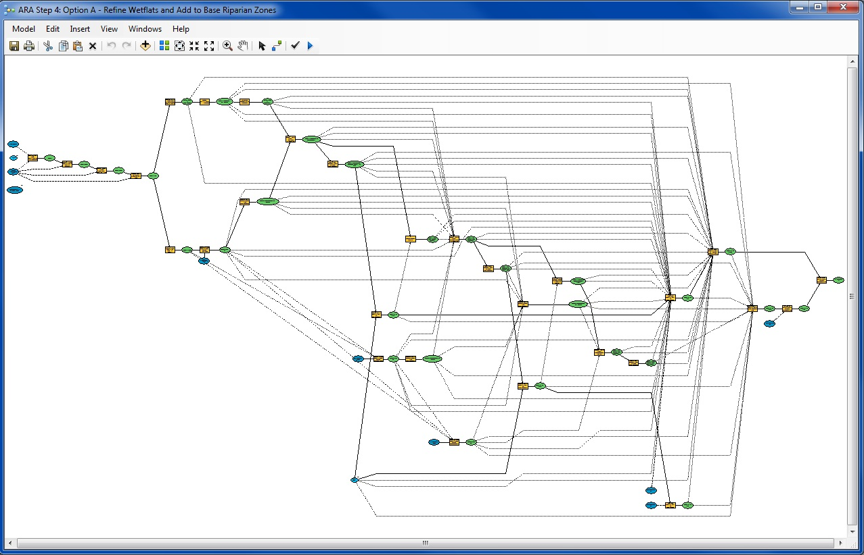
ModelBuilder can be taken too far:
Notes:
This is an actual screenshot of a ModelBuilder model that I was sent at work by a client. Picking it apart to understand the whole process took a long time, but only because it’s a cumbersome interface. This could be translated into a much more understandable ArcPy script.

Slide 9
Why bother learning ArcPy? (cont.)
Reason #2: Extendability
Leverage Python’s functionality in GIS workflows
Lots of other open-source GIS modules are in Python. Python is becoming a lingua franca of GIS
Notes:
Reason number two for learning arcpy is extendability. There is a ton of awesome Python functionality that you can leverage in your GIS workflows through arcpy. There’s string manipulation through regular expressions, XML support, HTTP support, modeling, etc. Python can serve as the glue that brings together many disparate datasets and processes in a highly customizable way. I once had a big processing task that ran over the weekend, and I added some code that emailed me an update every hour so I could stay on top of its progress without driving into work. Now that’s something you could never do in ModelBuilder.
I should also mention that there is a large community of GIS developers who use Python. By using arcpy, you can also leverage their work so you don’t have to reinvent the wheel.

Slide 10
Showcase 1: Hydrologic Analysis
What rivers are most likely to be impacted by runoff?
Important in process of siting water quality monitoring stations
Data available:
Hydrography (vector – line)
Land cover (raster)
Dams and culverts (vector – point)
Soil characteristics (vector – polygon)
Pesticide use (raster)
Etc.

Slide 11
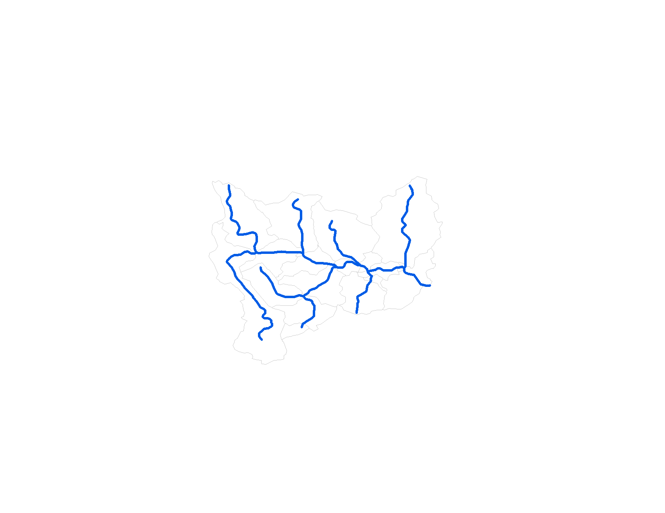

Slide 12
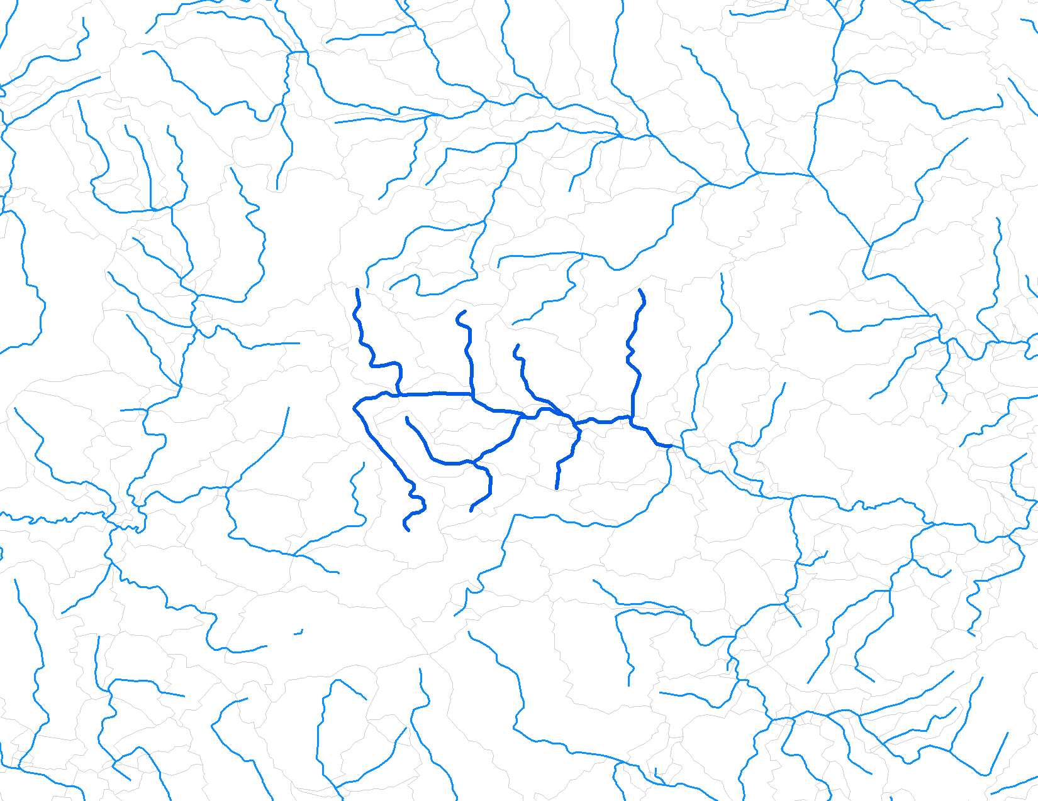

Slide 13
Showcase 2: Batch map creation
How to efficiently create lots of similar maps?
If we knew we only had to do it once, it might be fastest to do “manually,” making maps one-by-one.
Data driven pages has some functionality.
But inevitably, someone will want the legend moved half an inch, or some other cosmetic change applied to every !@#% map.
The arcpy mapping module is the most advanced solution to automating static map creation.

Slide 14
Showcase 3: Service Area Model
How can we model (i.e. estimate) the extent of drinking water utility service areas?
Relevant for water contaminant regulatory development and environmental justice
Data available:
Rough location of water utility (mailing address, ZIP code)
Population served by water utility

Slide 15
Demo
Task: Add field(s) to a shapefile
As always with ArcGIS, there are multiple ways to get it done
Notes:
Let’s get warmed up with a pretty straightforward Python routine. We want to add some fields to a shapefile’s attribute table. How would you do it?

Slide 16
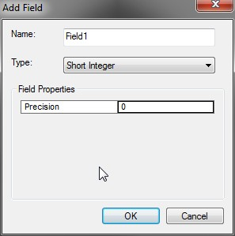
Method 1: Attribute table
Notes:
Method 1 is to use the ArcMap GUI. You would go to the Attribute Table, and then Add Field.

Slide 17
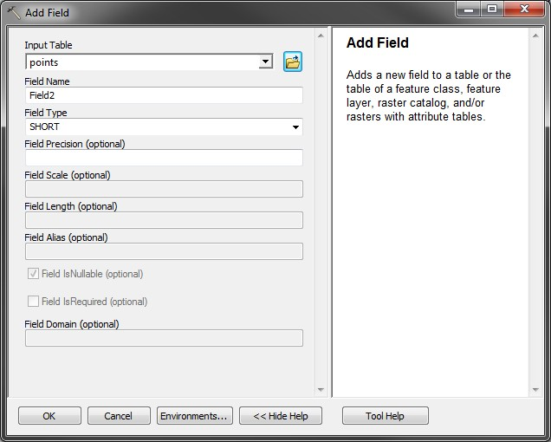
Method 2: ArcToolbox tool
Notes:
Method 2 is to use the Add Field geoprocessing tool in the Data Management toolset of ArcToolbox.

Slide 18
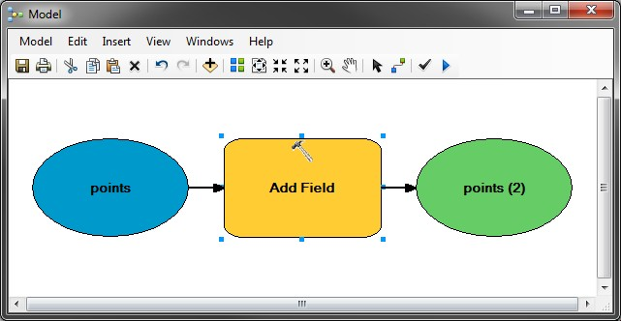
Method 3: ModelBuilder
Notes:
Method 3 would be to use the geoprocessing tool as part of a ModelBuilder model.

Slide 19
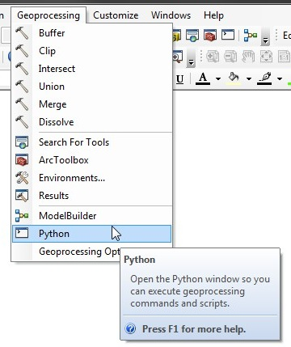
Method 4: Python
Open the Python window in ArcMap by clicking the Python button in the Geoprocessing menu
Notes:
Or we could do it in Python. Getting started in Python can be very intimidating. Just like with ArcMap, it’s hard to know how to approach a problem until you have a critical mass of knowledge about the software.

Slide 20
Python basics
Command line interface (CLI) runs Python and arcpy commands
In some software, the graphical user interface is merely an abstraction layer over the CLI
Python console in ArcMap is suitable for running small snippets of code and testing syntax; not suited towards running entire programs
Notes:
The Python command line interface is the place where we issue commands. These are interpreted by Python and then executed. If there’s a problem with the instructions, it will tell us.
In many software packages, the “normal” UI that you use is actually just an abstraction layer over the command line interface. When Windows 95 first came out, the listing, moving, copying, renaming, and deleting functionality in what is now called Windows Explorer was just a graphical interface that invoked the command line functions for modifying files.
For ArcMap, the Python console is a handy way to run small snippets of code or test your syntax. Larger programs are more easily edited in a standalone script file containing a series of these instructions. We’ll get to that later.

Slide 21
Python basics (cont.)
print is the command
“Hello world!” is a string object that is output by the print command
Notes:
First, let’s start out with some Python basics. This command outputs the string object “Hello world!” to the console. Python works with all different kinds of objects, strings being one of them. Strings are just a series of alphanumeric letters, similar to the TEXT field in a shapefile’s attribute table.

Slide 22
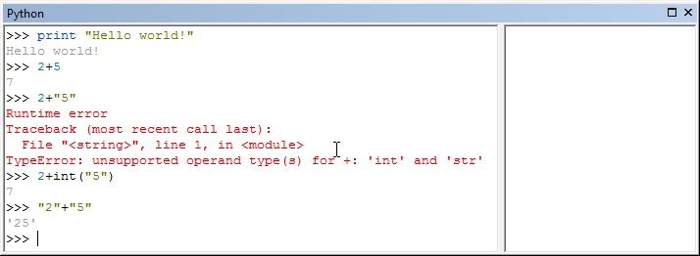
Python basics (cont.)
Python treats “+” as sum, which works as expected with integer (int) and floating point (float) objects.
You can’t sum an int and a string (str), but you can concatenate two strings.
Notes:
There are also integer and floating point number fields. The plus operator can be used to sum two numbers together, as shown here. But of course, you can’t sum a string and an integer. But the plus operator will concatenate two strings together.

Slide 23
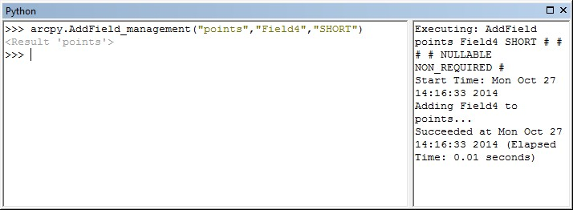
ArcPy commands
Every tool accessible from the ArcToolbox and Search panes can be run from ArcPy.
In the example above, the Add Field tool from the Data Management toolbox is run.
Notes:
In addition to the regular Python commands that anyone has, you can also access ArcGIS geoprocessing tools from the command line interface. In this example, we’re adding a field of type “SHORT” called “Field4” to the layer named “points”. Note that all three of these parameters are passed into the arcpy function as strings.

Slide 24
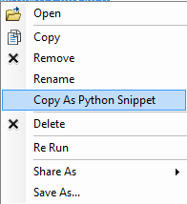
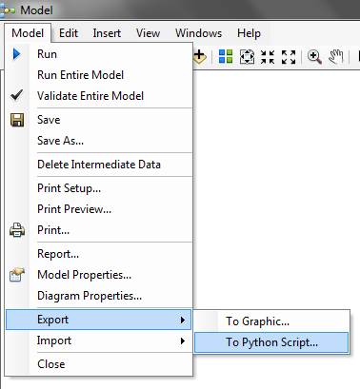
ArcPy commands (cont.)
How to find a command’s syntax?
Console code completion
Web documentation: http://resources.arcgis.com/en/help/main/10.2/
Export geoprocessing results to Python snippet
Export ModelBuilder to Python snippet
From results window
From Model Builder
Notes:
There are multiple ways to determine the correct syntax for a command. You can use the code completion in the console, look it up on the web documentation, or even export results or ModelBuilder models to Python script files. (This last method is how I taught myself ArcPy).

Slide 25
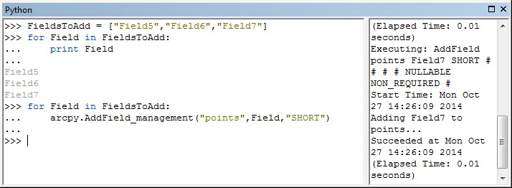
ArcPy commands (cont.)
FieldsToAdd is a Python list containing string objects that can be iterated through in a loop.
In the for loop, the Field object becomes the pointer to each item in the FieldsToAdd list.
Notes:
One of the most important concepts in computer programming is control flow. If we want to accomplish a task multiple times, we could write out the entire code multiple times. But it’s a lot easier to use control flow functions like loops. These are similar to iterators in Model Builder in that they iterate over a series of objects.
In this example, we’re creating a list of strings. This is assigned to the variable “FieldsToAdd”. The for loop iterates through each of these strings, and substitutes the current string value as the variable “Field”. This variable is then used in the arcpy.AddField_management() function as before.

Slide 26
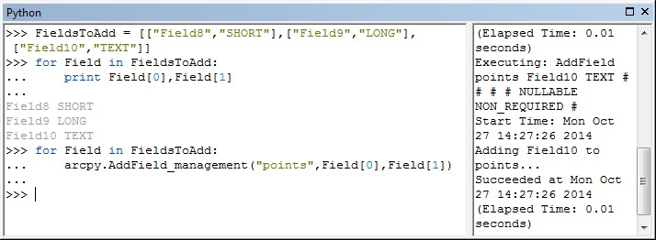
ArcPy commands (cont.)
You can nest lists within lists. Any loops iterate through the outermost list with 3 elements..
You can reference elements in a list by their index.
Field[0] returns the 1st element (a field name string).
Field[1] returns the 2nd element (a field type string).

Slide 27
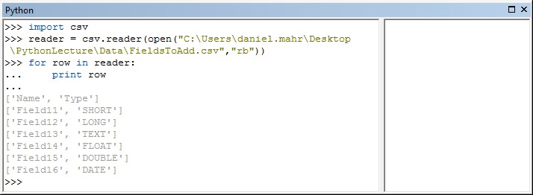
ArcPy commands (cont.)
Python has great support for reading and writing external files, such as CSVs and XMLs.
The reader object is the iterable being looped through, instead of the FieldsToAdd list.

Slide 28
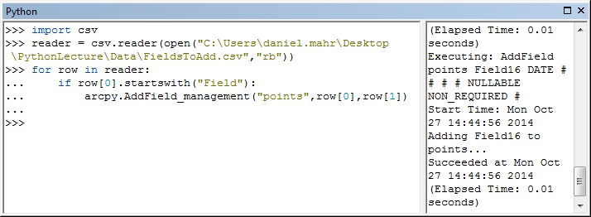
ArcPy commands (cont.)
The field names and field types from the CSV can be passed to the Add Field command.
The startswith() function can prevent inadvertently adding the header fields.
Right click to save this to a .py Python file.

Slide 29
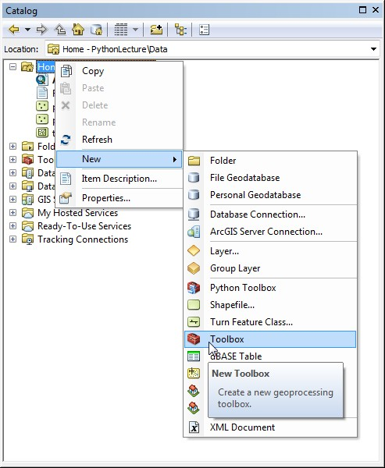
Creating a Custom Toolbox
Empty custom toolboxes can be made in the Catalog pane.
Each toolbox can contain multiple tools
Each tool references a Python script file with the .py extension.

Slide 30
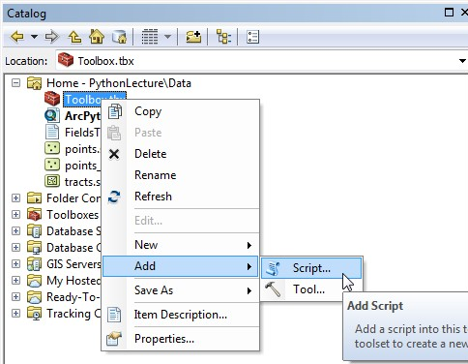
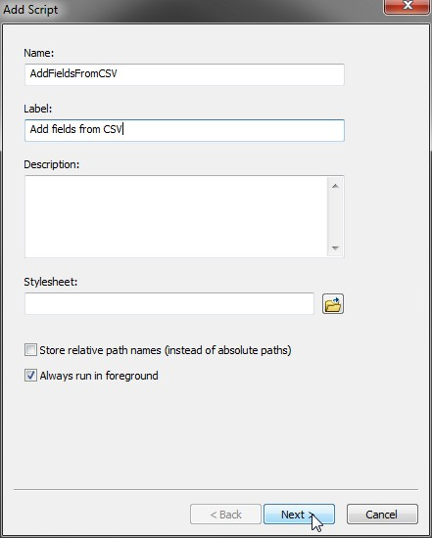
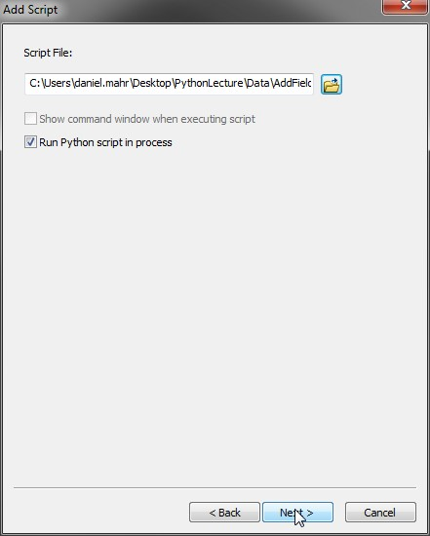
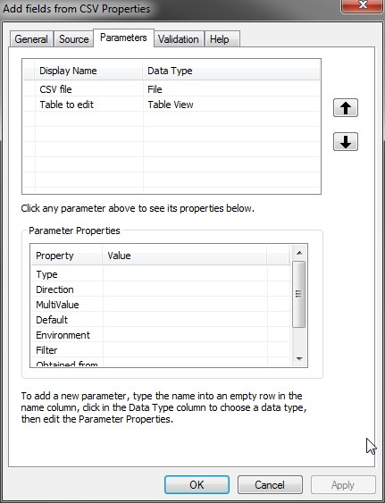
Creating a Custom Toolbox (cont.)

Slide 31
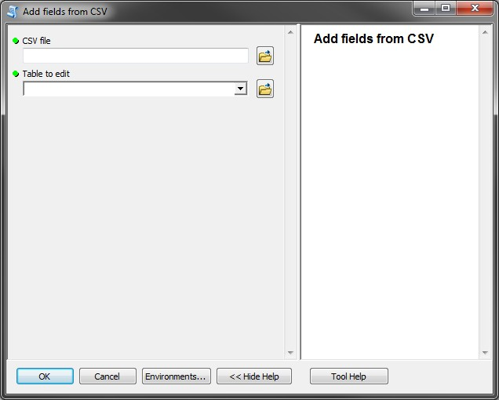
Creating a Custom Toolbox (cont.)

Slide 32
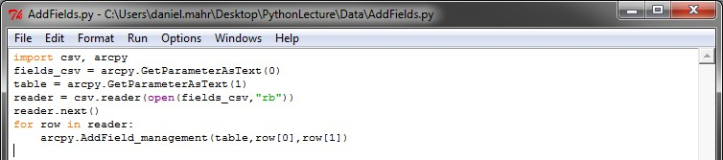
Creating a Custom Toolbox (cont.)
Import arcpy module
Handle header fields more elegantly using next()
Use parameter values from our toolbox tool instead of hardcoded .csv file and table layer.

Slide 33
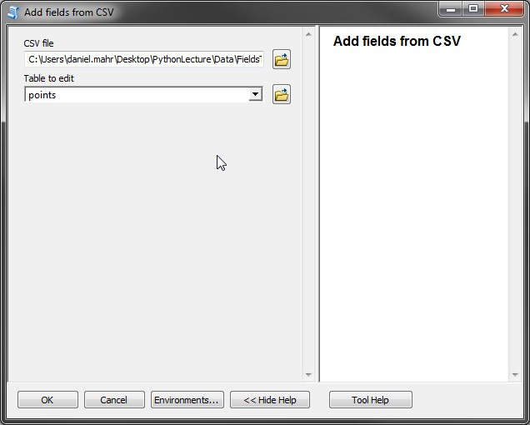
Creating a Custom Toolbox (cont.)

Slide 34
Questions?

Slide 35
Contact info and links
Dan Mahr ’11
dmahr1@gmail.com
Resources
ArcGIS 10.2 Help
http://resources.arcgis.com/en/help/main/10.2/
GIS Q&A at StackExchange
gis.stackexchange.com
Learn Python:
CodeCademy.com
DiveIntoPython.net

